Slide 1
Online Edu. Employment (Android)
Project Plan
VEL team
14 Aug. 2015

Slide 2
Project Plan
Agenda
1. Team VEL
2. Product Owner
3. Project Goal & Major Capability
4. Product Backlog
5. Development Plan
6. Scrum PM Tool
7. One User Story
8. Risk Management

Slide 3
1. Team VEL

Slide 4

2. Product Owner – CEO of GetSkills.co.nz
www.getskills.ac.nz
CEO have some concerns about their website
About Them:
New Zealand based IT training company
Objective: Teach, Train and Place
Placement is Commitment

Slide 5
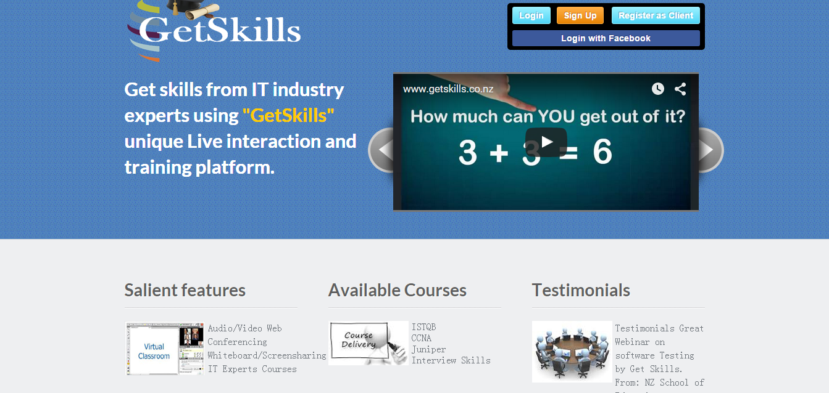
3. Project Goal and Major Capability
getskills.co.nz/

Slide 6
3. Project Goal and Major Capability
Major Capabilities:
1) Visitor ----- view the website, scan the course list, take a test without registering
2) System (course advisor) ---- give the user a short survey, give a list of successful examples, recommend some suitable courses
3) User ---- select courses, make payments online, take courses via video or audio

Slide 7
4. Product Backlog
S.No. | Priority Level | Product Backlog
1 | 1 | Getskills website should adapt the size of the browser automatically with respect to the device in which the website is seen. For e.g. if the website is seen then the mobile phone, then the browser should change its size according to mobile phone screen, and display its contents properly. If the website is viewed from a Tablet / Laptop then the browser should change its size automatically in such a way that it displays content properly in the tablet/Laptop respectively.
2 | 2 | As a visitor to "GetSkills" website, the visitor can select a test and make payments to the selected tests, without registering in the Getskills website.
3 | 2 | Visitors of Getskills website is categorised based on the survey. Based on the category, Successful stories of alumni's associated with Getskills is published. On viewing the Successful stories of Alumni, the visitor is prompted to take a similar course / test that is available in Getskills.
4 | 3 | An exclusive webpage is allotted to promote Getskills Automation Tool, with Successful stories of automation tool implemented companies.

Slide 8
5. Development Plan

Slide 9
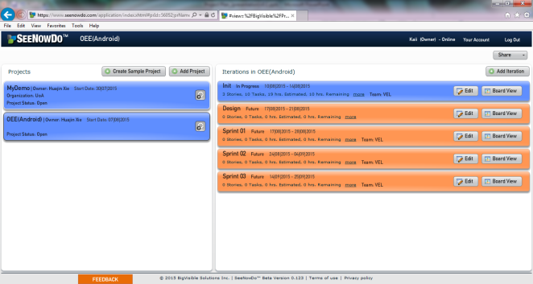
6. Scrum PM Tool (1)
SeeNowDo
URL: https://www.seenowdo.com/pages/login/index.html
Project Name: OEE(Android)
Image of project list & iteration list

Slide 10
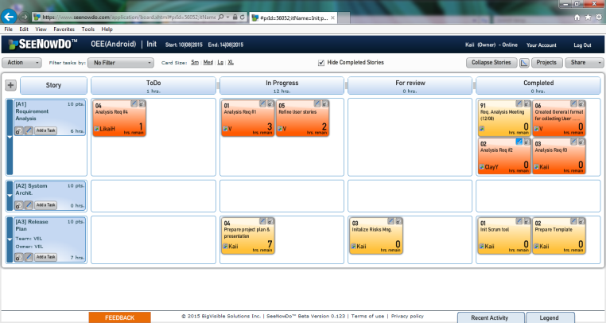
6. Scrum PM Tool (2)
SeeNowDo
Image of User Stories and Tasks List of one sprint

Slide 11
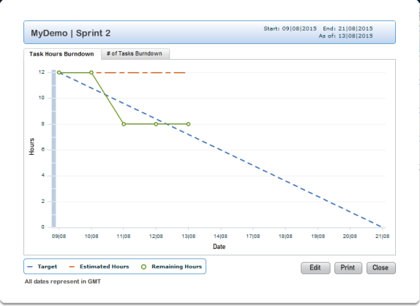
6. Scrum PM Tool (3)
SeeNowDo
Image of Burn-Down Chart

Slide 12
7. One User Story (1)
User story #1
As visitor, when I use mobile devices (phones and pads) to access the website, I want to see that the framework (the header, footer and buttons) of this website is suitable for my using behavior on mobile devices
So that I can use this website on mobile devices as convenient as on PCs.
Notes:
So much about scrum process, let me show you one particular user story which is prioritized on the top by customers.

Slide 13
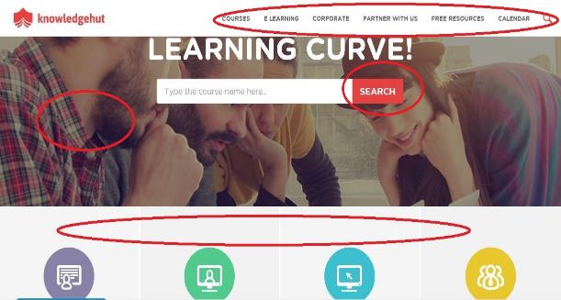
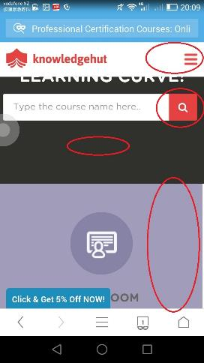
7. One User Story (2)
On phones, the menu, button, picture and layout may change from what you see on PCs .
Notes:
As we all know, the phone screen display website in a different way from computer screen.
The google has stated that they will block the websites which are not suitable for mobile device screen.

Slide 14
7. One User Story (3)
User story #1
As visitor, when I use mobile devices (phones and pads) to access the website, I want to see that the framework (the header, footer and buttons) of this website is suitable for my using behavior on mobile devices
So that I can use this website on mobile devices as convenient as on PCs.
Device type detection
DPI & resolution detection
Dynamically changing style
Notes:
To satisfy this user story, we need to detect device type and resolution, then calculate the DPI. Last but not least, dynamically change display by CSS.
We can just use phones or pads to logon this website, check whether the layout changes or not.

Slide 15
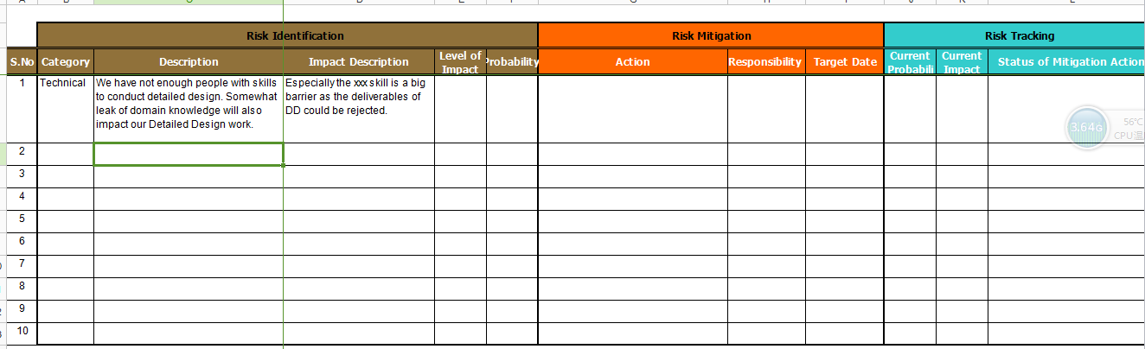
8. Risk Management
The Risk Tracking will be carried out after daily scrum. You can find the documentation in our GitHub, located /PCB/02 Plans & Actuals/2.3_Risk & Issue.

